Slide 1

Understanding How Behavioral Factors affect an Individual’s Health
Andy Jobe, Christian Ramos
Hussain Gardezi, Jeff Gielniak
Original Dataset: https://www.kaggle.com/datasets/kamilpytlak/personal-key-indicators-of-heart-disease

Slide 2
Data
Our dataset is collected from a large study performed by the CDC yearly where they interview over 400,000 individuals over the phone asking about their general well being, health issues, drug and alcohol use and physical statistics.
We will use this data to attempt to answer the following questions:
1. Does taking mental health days result in better overall health?
2. Are e-cigarettes or cigarettes better for you?
3. Is more sleep an indicator of better overall health?
4. What are the healthiest and least healthiest states?
5. Is there a correlation between depressive disorders and BMI?

Slide 3
Data: Limitation
All data was self reported. None of it was measured by a medical professional.
Some data points like General Health are presented in broad buckets that don’t accurately reflect the granularity of the measurement.
A cognitive bias to reflect positively on your decisions. People generally think they are healthier, smarter, taller etc then they are.

Slide 4
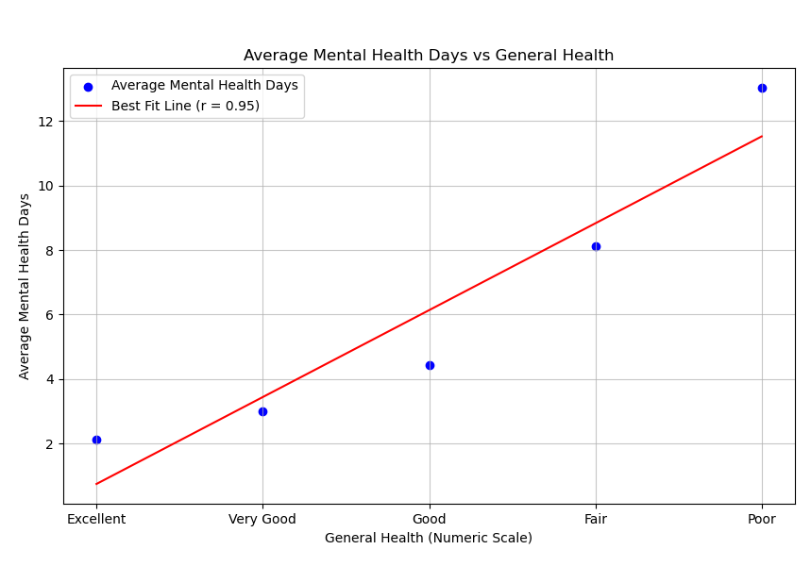
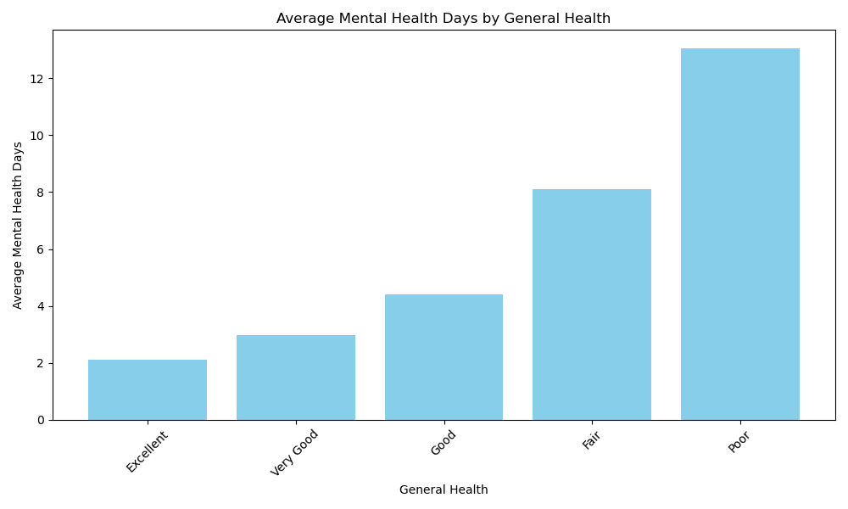
Mental Health Days vs Health
There is a strong positive correlation between the two variables, an R value of .95
The avg mental health days taken increases steadily as health decreases.

Slide 5
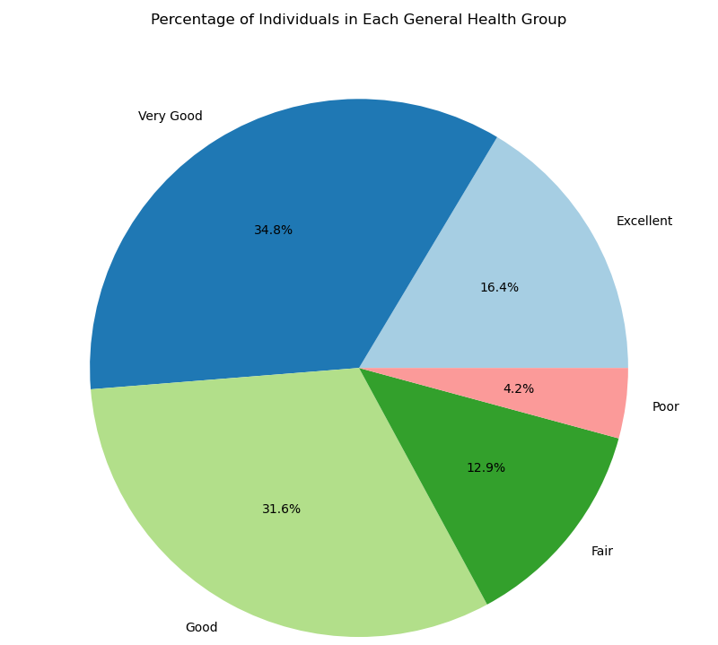
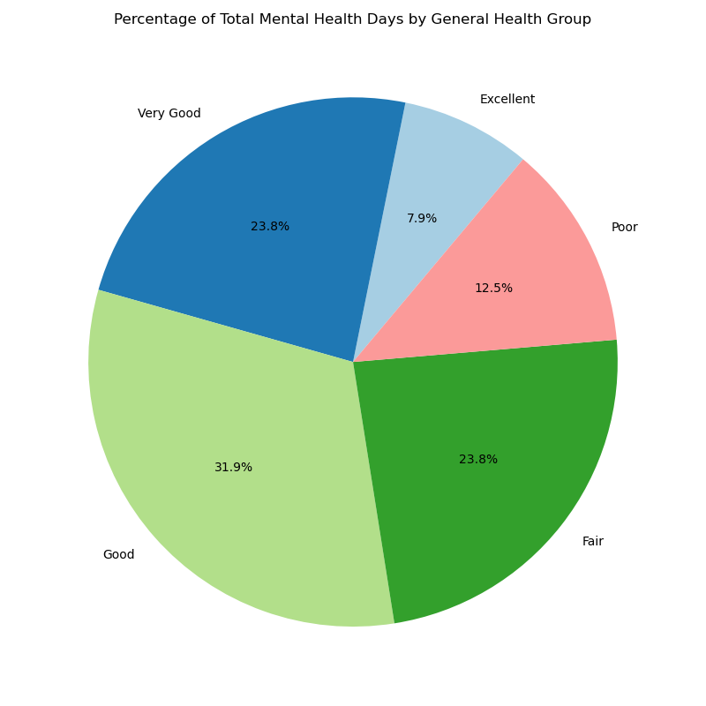
Mental Health Days vs Health: Validation
To ensure sufficient representation from each group I looked at the percent of individuals by health group, and the percent of total mental health days by group.
Notes:
Although individuals with excellent and very good health make up over 50% of the sample group, they make up ~32% of the mental health days taken.
Conversely individuals with poor and fair health only make up ~17% of the sample group, they make up ~36% of the mental health days taken.

Slide 6
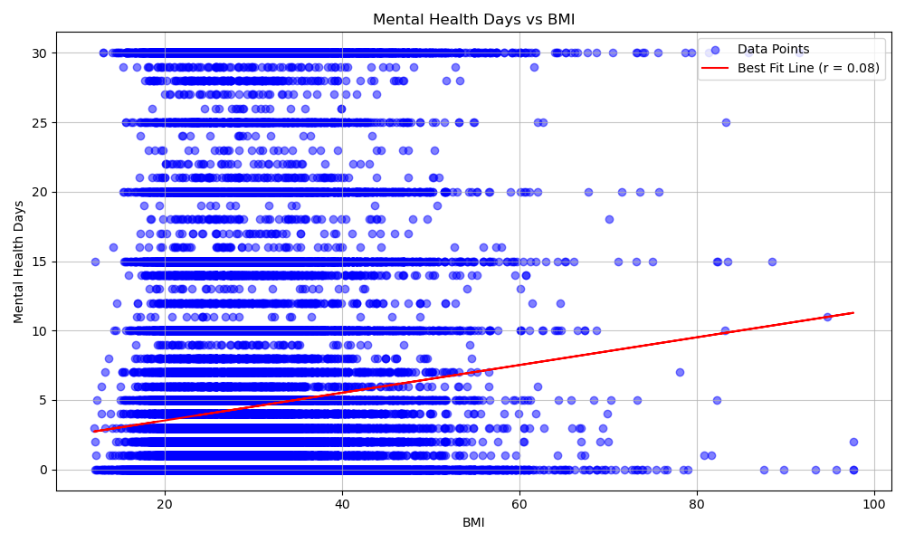
Mental Health Days vs Health: Caveat
Categorizing health into 5 buckets is not very specific so I wanted to use another proxy for health, BMI.
The results were less conclusive and uncovered potential shortfalls of the data.
Notes:
After day 5, there are large collections of data on increments of 5 suggesting that people might be taking mental health days not because they need them for health purposes but because their company gives them those days and they want to use them.
BMI could also be considered a more accurate or scientific way to measure health as is quantitative as opposed to the more qualitative approach with “excellent, very good, etc”

Slide 7
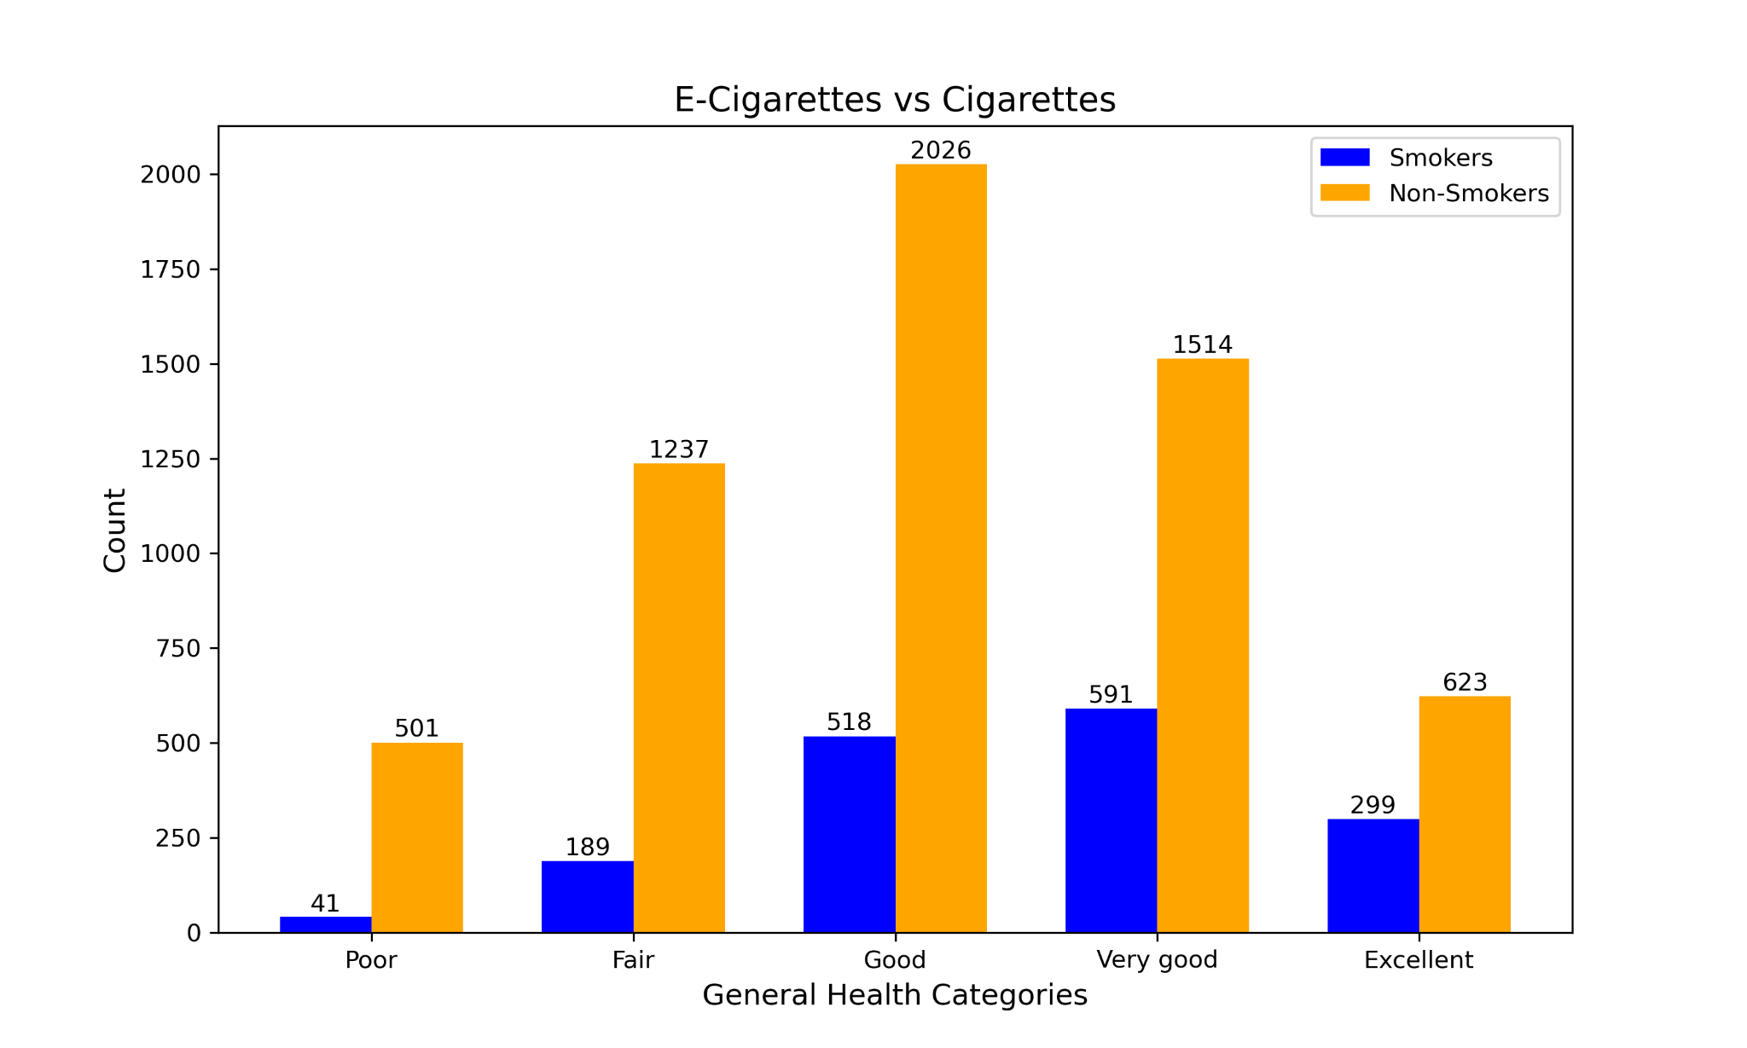
E-Cigarettes vs Cigarettes
These charts highlight the distribution of self-reported general health categories for smokers and non-smokers who use e-cigarettes
This breakdown helps us understand differences in perceived health among these groups

Slide 8
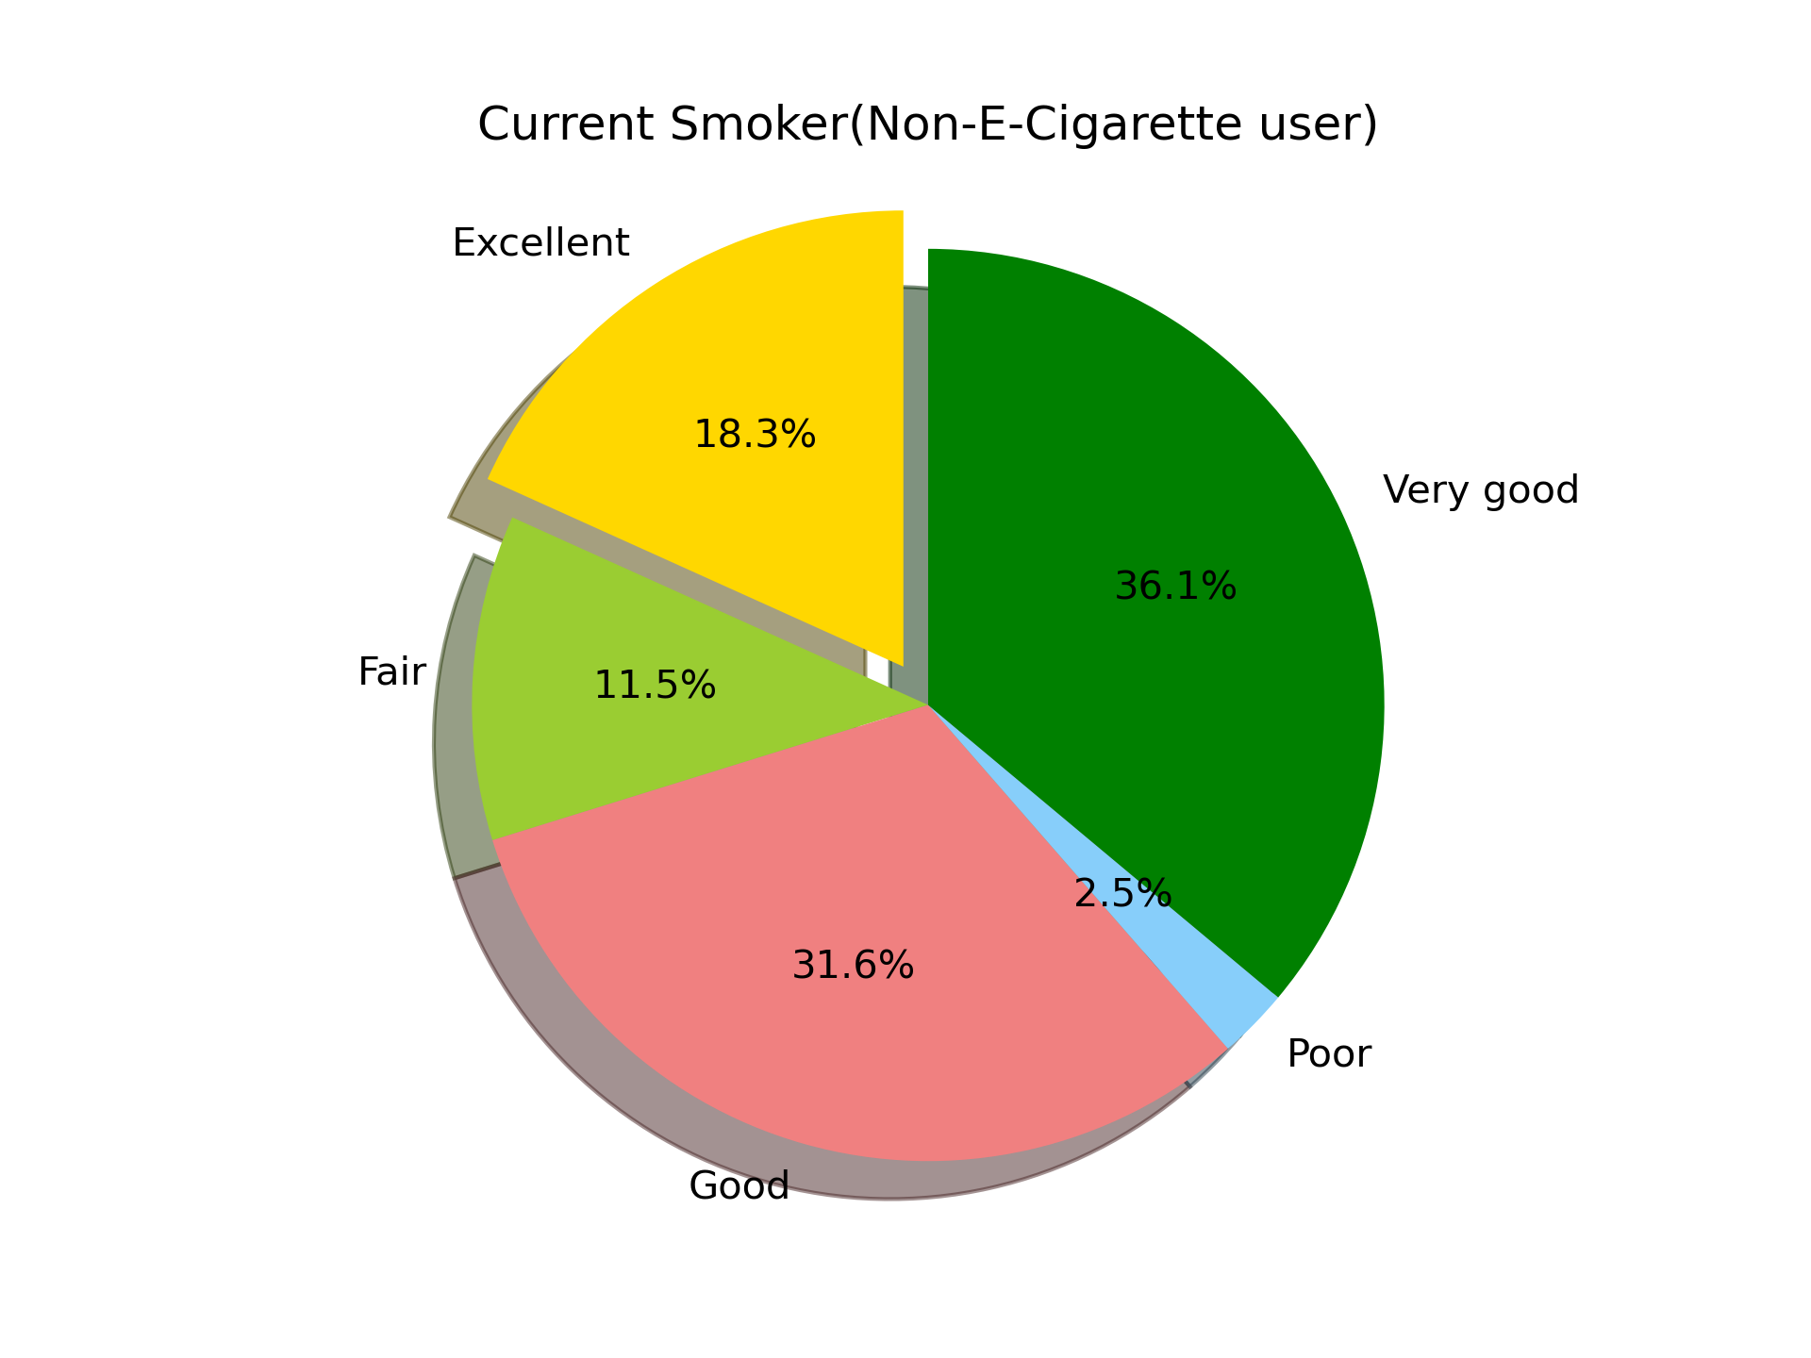
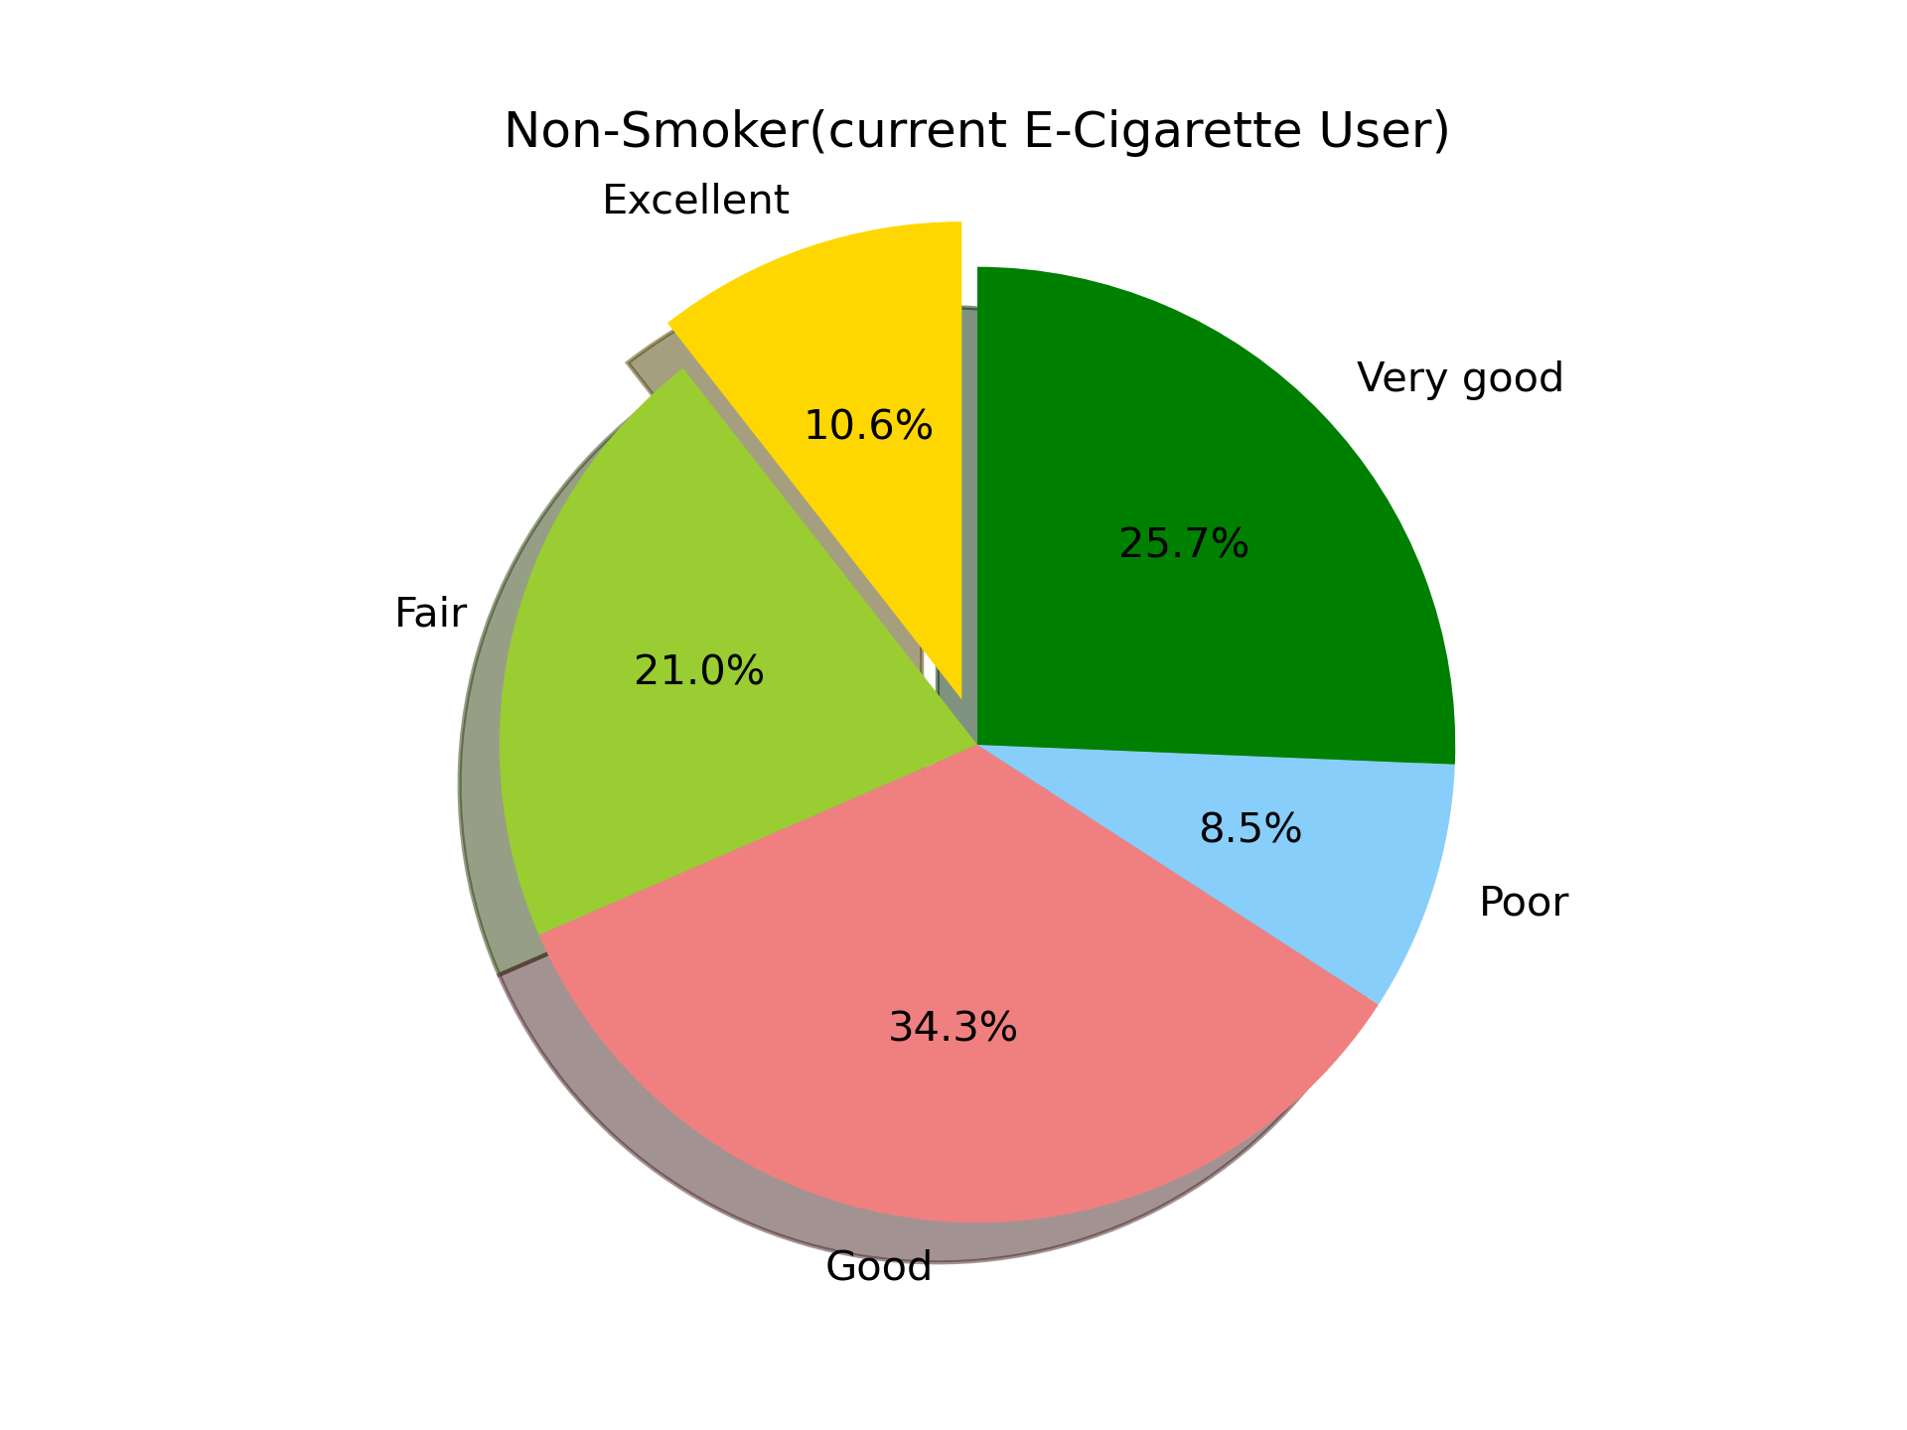
E-Cigarettes vs Cigarettes
Smoker: ~18% in Excellent Health E-Cig User: ~11% in Excellent Health
Smoker: ~2.5% in Poor Health E-Cig User: ~9% in Poor Health

Slide 9
E-Cigarettes vs Cigarettes: Results
Smokers may turn to E-cigarettes as a stepping stone to quitting or thinking it is a healthier alternative. However, for non-smokers, the use of e-cigarettes does not appear to significantly improve health outcomes and actually indicates those individuals are in worse health.
The graphs show how people feel about their health, not actual medical results. While this gives useful insights, it doesn’t show the full long-term effects of e-cigarettes. Factors like existing health issues, age, lifestyle, and how often e-cigarettes are used could also affect the results
Very small populations for this particular data likely make for very noisy conclusions (1,600 E-Cig users / 5,000 Smokers in ~90k individuals surveyed)
Notes:
The data does not indicate whether e-cigarette use directly improves health or whether smokers and non-smokers perceive their health differently due to external factors.

Slide 10
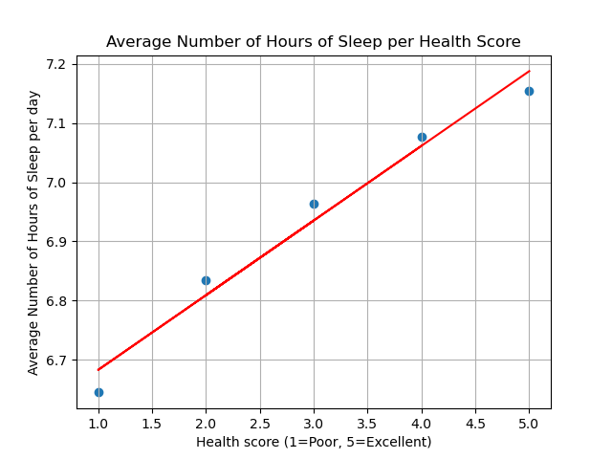
Sleep vs Overall Health
6.65 hours for Poor
7.15 hours for Excellent
Clear positive correlation
0.13 hours (8 minutes) = 1 jump in Health Score.
Approx 40 minutes from Poor to Excellent
y = 0.13x +6.56
The R-Squared value is: 0.973
Notes:
Will getting more sleep lead to better overall health? Took average sleep score for the five different reported Health scores. Clear positive relationship between the two variables. Strong representation of the data by the linear regression because of R-squared value

Slide 11
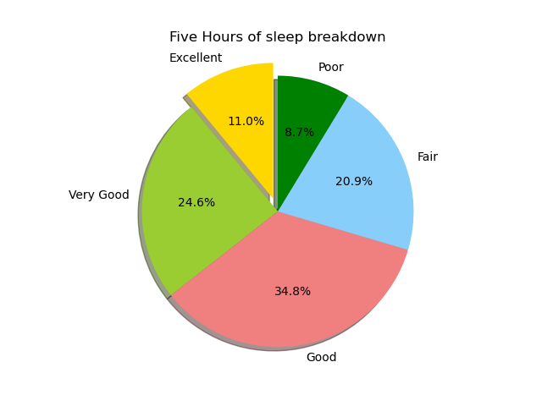
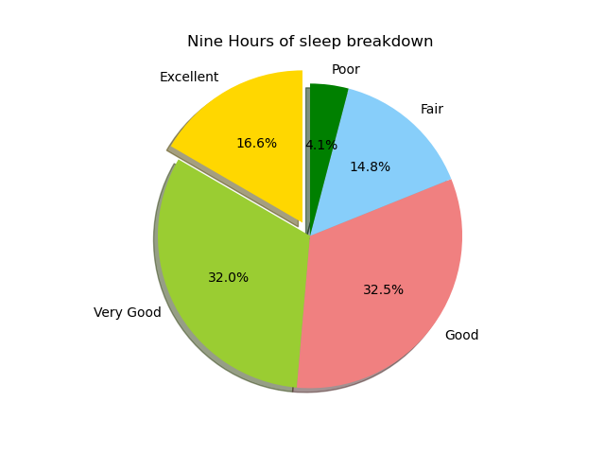
Sleep vs Overall Health: Results
Clear improvement in Health when comparing 5 hours to 9 hours daily sleep
Noise: People with health conditions may have difficulty sleeping
Notes:
Looking at two reasonable extremes. Is there an indication of better sleep equating to better health?

Slide 12
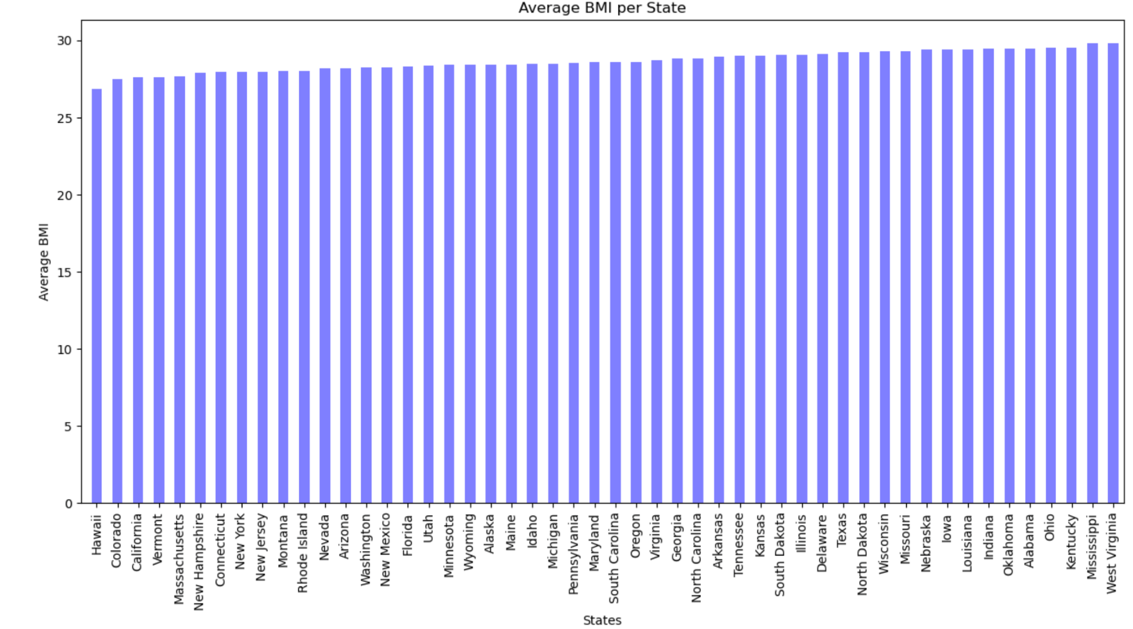
Health vs States
Hawaii = 26.84 West Virginia = 29.82
Notes:
Simple bar chart visualizing average BMI for individuals of all 50 states.

Slide 13
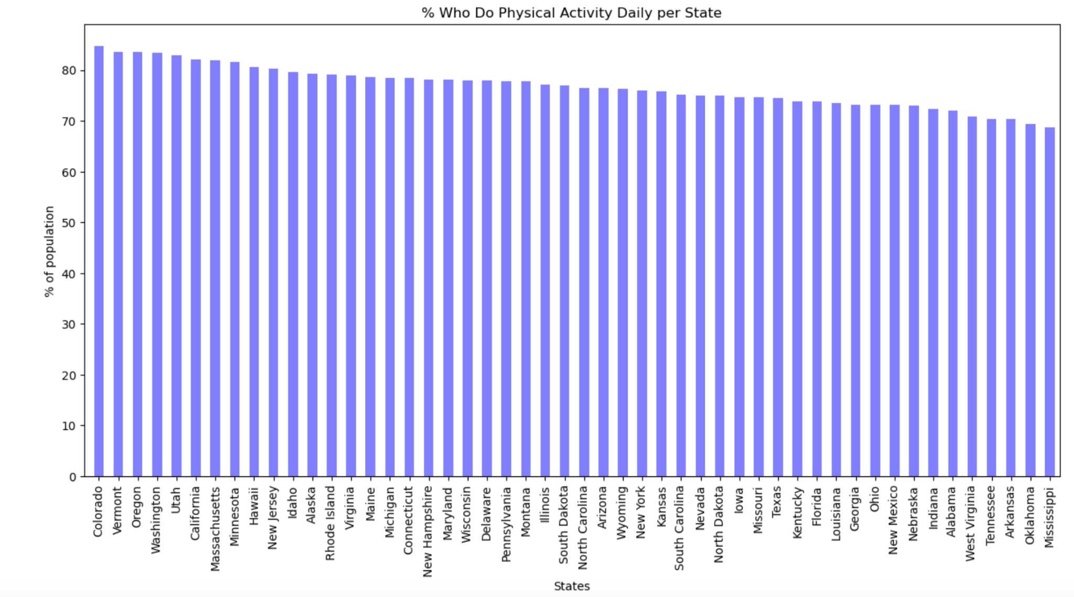
Health vs States
Colorado = 84.78% Mississippi = 68.68%
Notes:
Percent of respondents in each state that do Physical Activity daily. Colorado and Vermont in top 2 in both, West Virginia and Mississippi in bottom 5 in both.

Slide 14
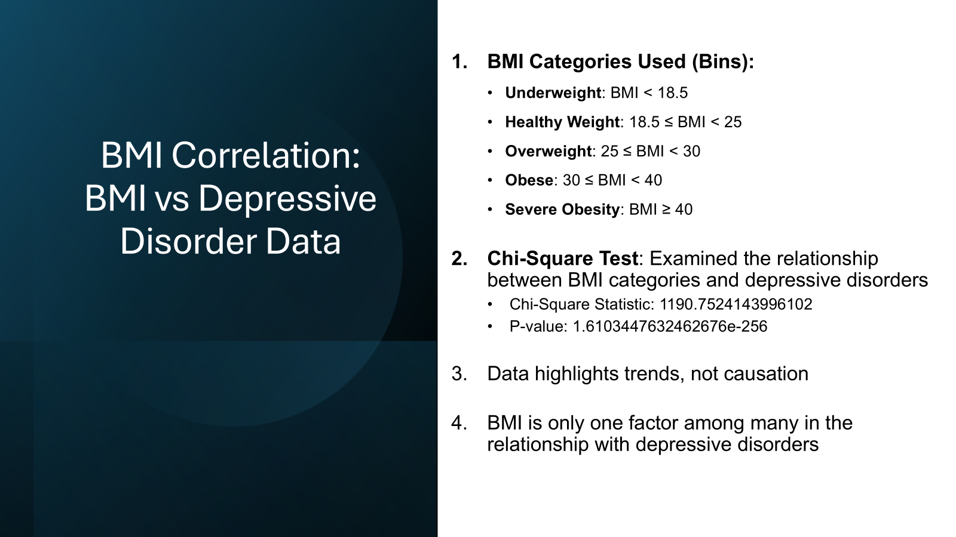

Slide 15
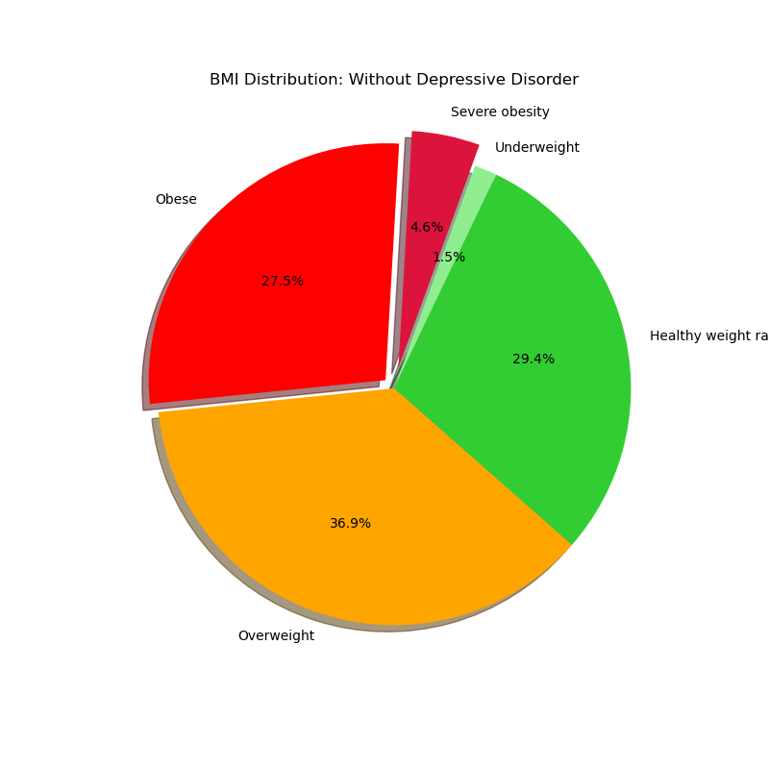
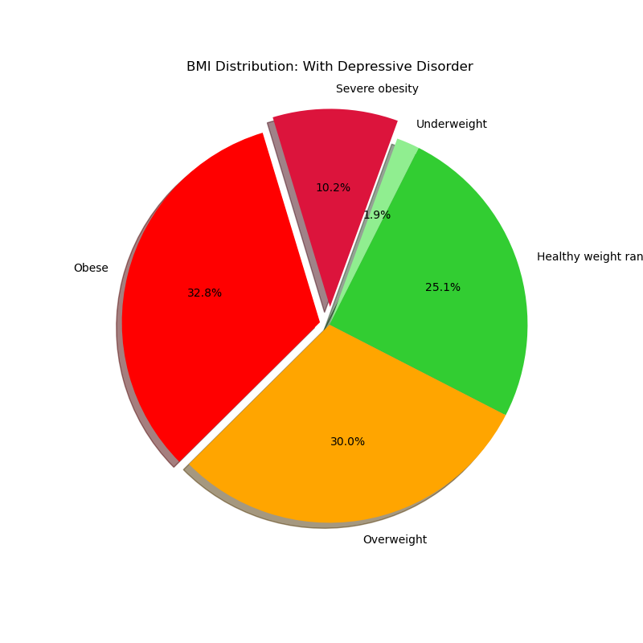
BMI Correlation: BMI vs Depressive Disorder
BMI Distribution: Without Depressive Disorder
BMI Distribution: With Depressive Disorder
Severe Obesity
Severe Obesity
Underweight
Underweight
Obese
Obese
Healthy weight range
Healthy weight range
Overweight
Overweight
Individuals with depressive disorders are more likely to fall into the Severe Obesity category (10.2% vs. 4.6% for those without depressive disorders)
The proportion of Obese individuals increases significantly to 32.8%, compared to 27.5% for those without depressive disorders.

Slide 16
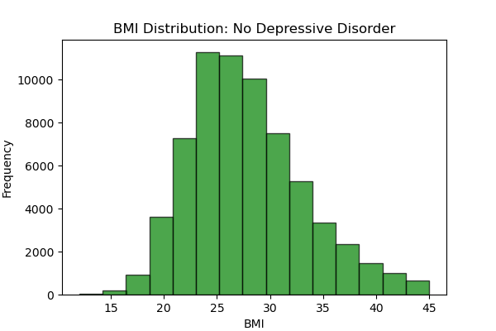
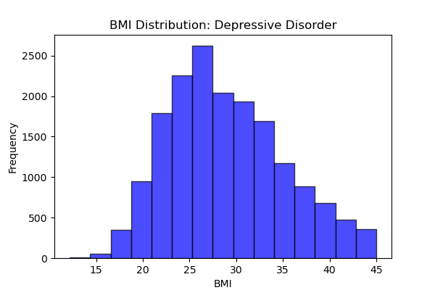
BMI Correlation: BMI vs Depressive Disorder
Longer tail for higher BMIs in depressive disorder group
Obesity and severe obesity are more prevalent in depressive disorder cases
Fewer individuals with depressive disorders fall into the healthy BMI range

Slide 17
Thank you!

